Slide 1
Predicting Country-Level Life Expectancy
Team:
Nicole Fisher, Huanhui Hang, Komal Kishore
Fi

Slide 2
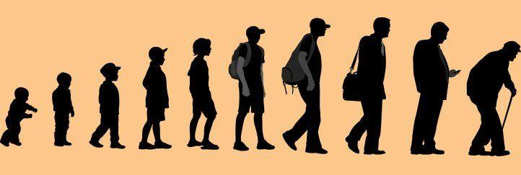
Topic and Motivation
For our topic, we chose to research how we can most accurately predict life expectancy.
Life expectancy is a key metric for understanding a country’s health.
A number of economic, social, and health related variables can help predict life-expectancy.
Historically, global life expectancy has risen. However, this varies by country.
By examining various factors to determine the life expectancy, we can then use this data to influence solutions such as health, policy, foreign aid, and global living standards.

Slide 3


The Data – WHO & UN
Data for each of 193 countries from 2000-2015 compiled from WHO and UN
Joined with region data from CIA World Factbook
Original data set contains 2938 observations of 22 variables
All predicting variables was then divided into several broad categories:​Immunization related factors, Mortality factors, Economical factors and Social factors.
Age
Region
Hepatitis B
Adult Mortality
Numeric (yrs)
Categorical
Numeric (immunization %)
Numeric (deaths/1000)
Infant Deaths
Alcohol
Measles
Income Composition of Resources
Numeric (deaths/1000)
Numeric
(range 0-1)
Numeric (cases/1000)
Numeric
(range 0-1)
Notes:
Note: income composition of resources is between 0 and 1, related to HDI and based on economic measures like GNI and GDP per capita.
Each observation describes life expectancy and other key health, social, and economic conditions for a country in a given year. These include infant deaths per 1000, government expenditure on health, income composition of resources, and more.
Credit for datasets in final slide

Slide 4
The Data – Suicides
Suicide data for each of 193 countries from 1985-2016 compiled from WHO
Original data set contains 27820 observations of 12 variables
All predicting variables was then divided into several broad categories:​ Age group, Country, Year, GDP, Population, Sex
Age
Country
Year
Population
Numeric (yrs)
Categorical
(Numeric (yrs)
Numeric (deaths/1000)
Sex
GDP
Categorical
Numeric
(range 0-1)
Notes:
Note: income composition of resources is between 0 and 1, related to HDI and based on economic measures like GNI and GDP per capita.
Each observation describes life expectancy and other key health, social, and economic conditions for a country in a given year. These include infant deaths per 1000, government expenditure on health, income composition of resources, and more.
Credit for datasets in final slide

Slide 5
EDA
Notes:
We specifically chose 2011 because it is the latest year among the years with the least missing data (no variable has a missing rate greater than 22%).
The interaction is apparent in the presence of two rough lines in the upper right figure. However, as shown this is not an interaction with infant deaths. We also checked that it was not an interaction with region; the countries on the steeper line on the left are from varying regions.
Also notable, some variables appear to be correlated with each other. For example, infant deaths and under-five deaths are obviously linked, which means that one or the other is unnecessary for modeling. This was addressed in the model construction.

Slide 6
Modeling Procedure

Slide 7
Interesting Findings From The Model

Slide 8
Conclusions and Future Work

Slide 9
References

